Slide 1
Crafting Theology from Revelation
The heavens declare the glory of God (Psalm 19)
Building a Theological Belief System

Slide 2
What is this about?
“Blessed are the ears that hear the pulse of the divine whisperer, and give no heed to the many whisperings of the world”
Thomas Kempis
(1380-1471)

Slide 3
Theology is
Theos = God Logos = word
Theo-logos (theo-logy) = words about God!
“Theology is reflection upon the God whom Christians worship and adore.” (McGrath, 1)

Slide 4
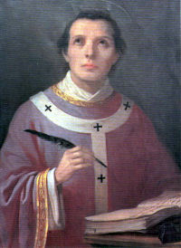
Theology is
“Theology is faith seeking understanding”
Anselm of Canterbury (1033-1109)
Notes:
Note: We start with faith – “I believe” – then ask: “what does it MEAN to believe?” - the “what does it mean?” is theology

Slide 5
Why is this important?

Slide 6
Knowing God
Theology is to Christianity as the marital relationship is to a husband and wife. If you love each other you will spend a lifetime learning everything you can about each other. If you love God you will do the same!

Slide 7
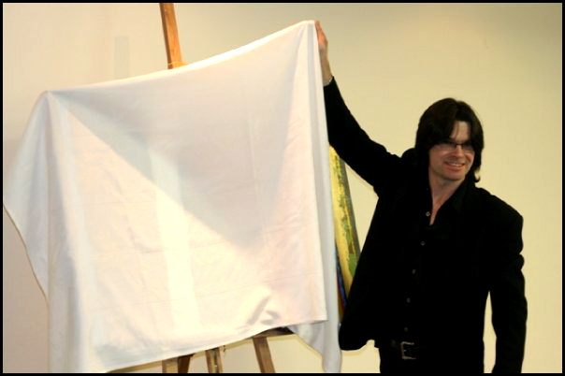
Revelation = Unveiling

Slide 8
Revelation! Basic Assumption of Christianity
“Christian theology can do no other than presuppose revelation, that God has graciously spoken.”
Neil Plantinga

Slide 9
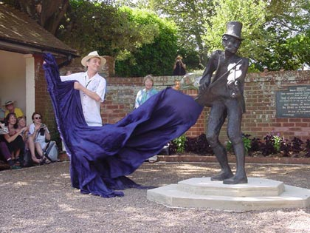
Revelation: Types
General Revelation (natural revelation)
“The heavens declare the glory of the Lord. . . ” Ps. 19: 1 - 4
“Natural knowledge of God via creation and providence apprehended by human reason, intuition, or conscience, resulting in natural theology” (52)
Special Revelation:
“All scripture is God-breathed and is useful for teaching, rebuking, correcting and training in righteousness so that persons of God may be thoroughly equipped for every good work.”
I Timothy 3: 16-17
“revealed knowledge of God via God’s particular historical or redemptive acts and words apprehended by faith (through the work of the Holy Spirit).”

Slide 10
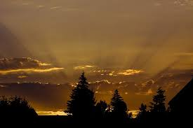
Revelation: Types (Table 3.1)
Special Revelation (Bible)
Revealed knowledge
Redemptive acts/words
Apprehended by faith (via Holy Spirit)
Accessible only by faith
Theology: sacred
General Revelation (nature)
Natural knowledge
Creation/providence
Apprehended by reason/intuition/conscience
Universally accessible
Theology: natural

Slide 11
Revelation: Further Reflection
General Revelation (natural revelation)
Thomas Aquinas – human reason largely uncorrupted by Fall – reason can be used to determine proof of God’s existence
John Calvin – “knowledge of God is implanted in human beings” = universal phenomenon of religious impulse in human beings
BUT – reason inadequate as distorted by sin
“At best they end up in idolatry, confusing the Creator with the creature.”
POINT: IT IS NOT ENOUGH FOR SALVATION!

Slide 12
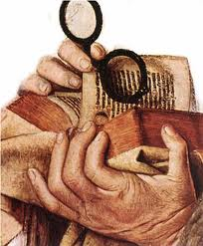
Special Revelation & Theology
The Four Main Sources of Theology
Bible (primary)
Tradition (secondary-interpreted)
Reason (tool-the means of interpretation )
Experience (culture) [secondary- interpreted)

Slide 13
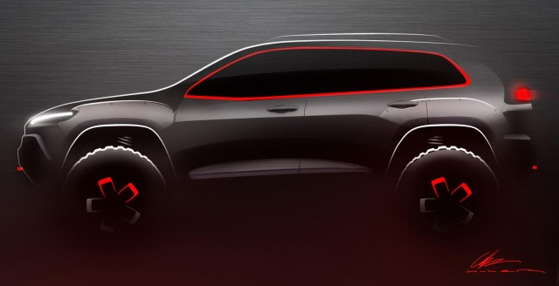
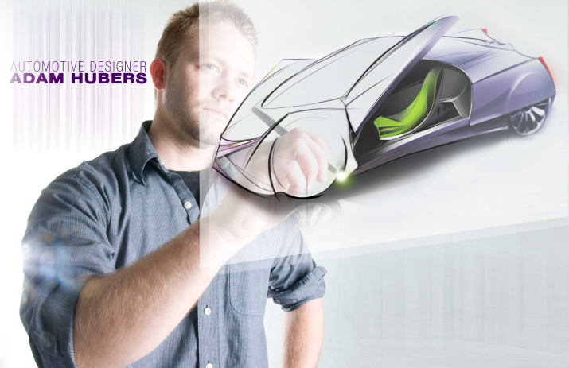
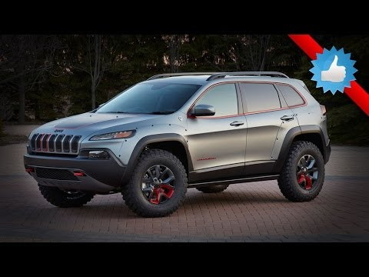
Designing Theology from the Sources
Jeep Cherokee Dakar Concept
My son, Adam, the designer

Slide 14
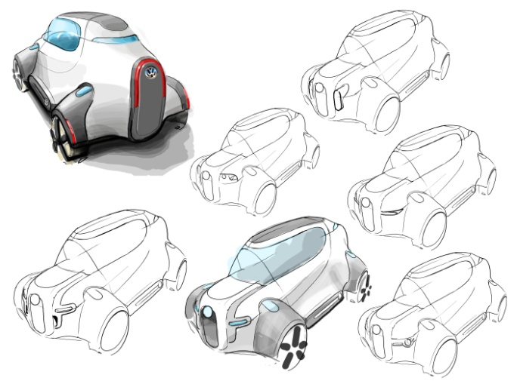
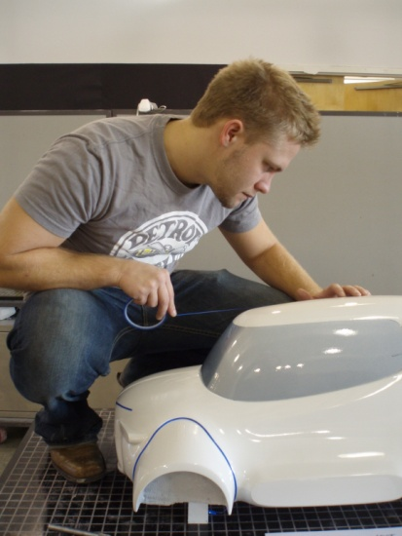
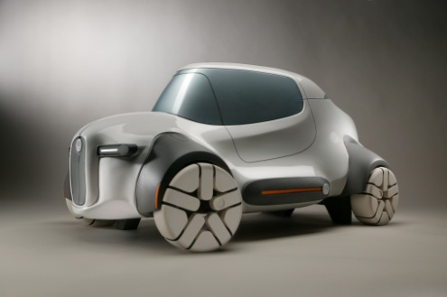
The Designing Task
Start with Basic concept: car
Reflect on classic designs (Chrysler)
Re-think classic designs in light of current context (eco friendly)
Test it out (does it work?)

Slide 15
Designing Theology
Working with the Materials
Bible: giving the basic concept – REVEALED by God
Tradition: classic designs based on REVELATION
Reason: working with the classic design (Bible & tradition) to fit the context of today
Experience: testing the product – does it work [i.e. produce a compelling Christian witness]?

Slide 16
Fashioning Theology: Epilogue
“[Theologians] need to fashion their theology as carefully as the stonemason crafted a medieval cathedral, or a woodworker crafts a fine cabinet, or a weaver crafts a fine piece of cloth.”
Stone, p. 39

